Slide 1
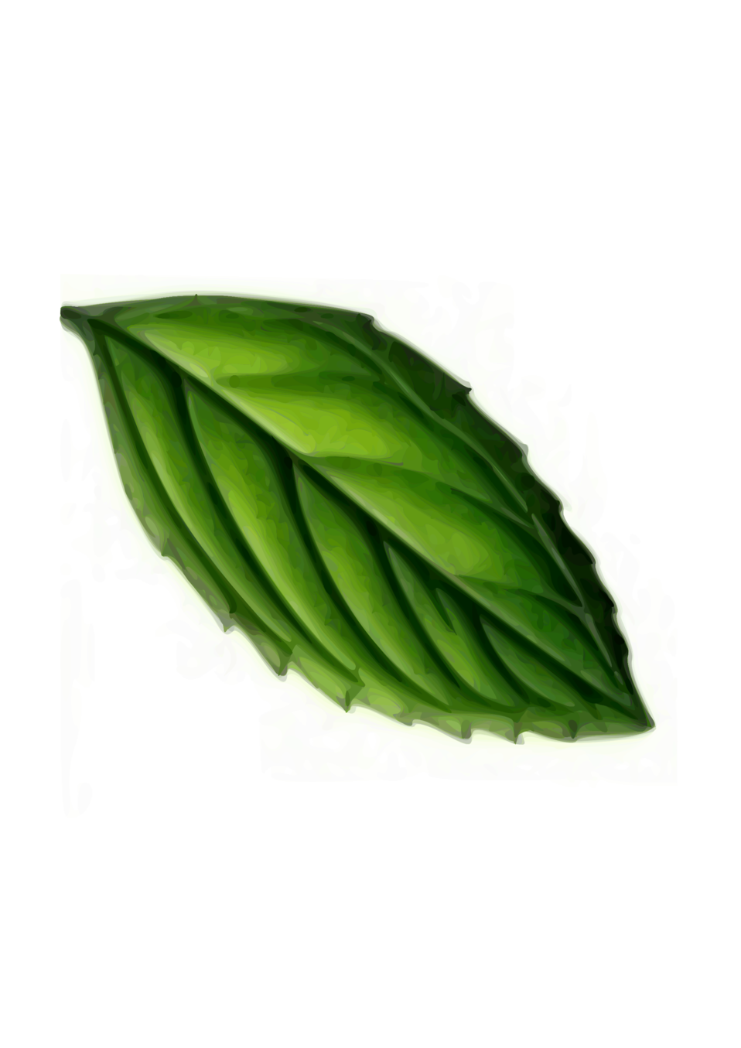
BASIL HERB
Bio-Automated System with Intelligent Lighting Hydroponics for Enhanced Rapid Bloom
Group 5

Slide 2
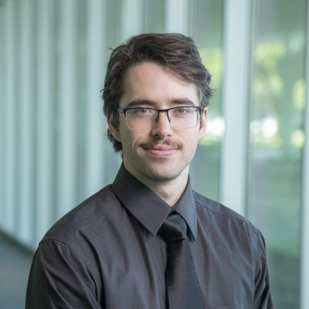
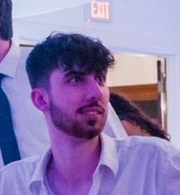
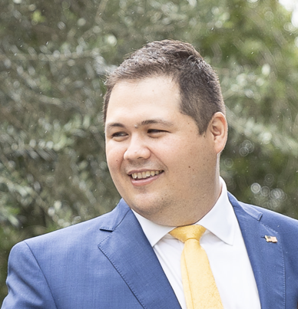

Intros
Casey O'Donahoe
Logan Voiselle
Justin Boyd
Justin Press
Computer Engineer
Computer Engineer
Electrical Engineer
Optical Engineer

Slide 3
Work Distribution
Creol | Tasks
Justin Press | Integration of LED lights
 | Color Sensor Selection and Integration
 | Light Sensor Selection and Integration
Electrical Engineering | Tasks
Justin Boyd | PCB Design
 | Water Pump Selection and Integration
 | Voltage Regulation
 | Water Level Sensor Selection and Integration
Computer Engineering | Tasks
Logan Voiselle | MCU Selection and Integration
 | Temperature and Humidity Sensor Selection and Integration
 | Communication to Web App
Computer Engineering | Tasks
Casey O’Donahoe | Website Design and Management
 | Software Design and Management

Slide 4
Motivation
Background
Juggling busy schedules makes traditional gardening difficult for college students.
Many want to grow organic food for health and sustainability benefits.
Up to 50% of home-grown basil dies due to inadequate care.
U.S. organic food sales hit $50.1 billion in 2019.
31% of college students struggle with maintaining a healthy diet due to time constraints.
Advances in photonics, engineering, and computer science have enabled smart greenhouses as a solution.
The global smart greenhouse market is projected to reach $2.1 billion by 2025.
Our goal: develop an intelligent greenhouse system empowering busy individuals to grow organic herbs.

Slide 5
Goals
Basic Goals:
Monitor and maintain optimal growing conditions
Implement efficient hydroponic system
Develop web app for data analysis and user interaction
Design portable, safe home setup
Advanced Goals:
Integrate optimal LED lighting
Add color sensor for deficiency detection
Stretch Goals:
Use ML for early plant health issue detection
Create mobile app for remote system control
Incorporate EMF generator for growth stimulation

Slide 6
Budget ($1,000)
Sub-system | Budget
Sensors, MCU, and Voltage Regulation | $150
Enclosure | $100
Hydroponics | $100
Lights and Seeds | $30
Software | $100
Total | $480

Slide 7
Objectives
Basic Objectives:
Integrate sensors with the following accuracy:
Temperature: ±2°C
Humidity: ±5% RH
Light intensity: ±5% of full-scale range
Design a hydroponics system with:
½-gallon water reservoir
Submersible pump (1-2 liters/min)
Tubing for continuous nutrient circulation
Develop a web app with:
Real-time sensor data display
AWS backend
Build a hardware enclosure:
Max dimensions: 24 inches
Durable, food-safe, water-resistant
Advanced Objectives:
Add adjustable LED lighting:
Blue spectrum (450-480 nm)
User-controlled intensity and duration
Stretch Objectives:
Create a plant health detection system using:
High-res camera and dataset of basil images
Machine learning for stress detection
Develop a mobile app with:
Real-time data, remote control, secure login
Integrate an EMF generator (0.1-30 Hz).

Slide 8
Milestones
EM Field Generator Delete
Finalize Housing
9/2
9/30
9/20
10/14
CDR Presentation
Fully Functional Prototype

Slide 9
Engineering Specifications
System Dimensions
Dimensions | < L: 600 mm x W: 600 mm x D: 600 mm
Weight | < 13 kg
Hydroponics System
Water Pump | ≥ 1 Liter per minute
Reservoir | ≥ 4 Liters
Water Level Sensor | ± 25 mm
Environmental Monitoring
Temperature Sensor | ±2 °C
Humidity Sensor | ±5% RH
Light Sensor | 0 to 100,000 lux
pH Sensor | ±0.5 pH
Color Sensor | ±5% Full-Scale Range
Growth Stimulation
Artificial Sunlight | 2,000 to 3,000 lumens
Adjustable EMF Emitter | 0.1 - 30 Hz
Web Application Deployment
Cloud Deployment | AWS Lightsail
Database Deployment | MySQL instance using AWS Lightsail
AI / ML Data Analysis
Speed of response from API | < 5000 ms
Data Export
PCB to Database | < 5000 ms
Web Application to PCB | < 5000 ms

Slide 10
Microcontroller Selection
 | Arduino MKR 1000 | ESP32-WROOM-32 | ESP32-WROVER | ESP32-S2
Processor | 1GHz single-core | Dual-core 240 MHz | Dual-core 240 MHz | Single-core 240 MHz
RAM | 32 KB | 520 KB SRAM | 520 KB SRAM + 4 MB PSRAM | 320 KB SRAM
Wi-Fi | Yes | Yes | Yes | Yes
Bluetooth | Yes | Yes | Yes | No
GPIO Pins | 8 | 26 | 26 | 32
Power Consumption | 0.231-1.056W | 0.528-1.056W | 0.528-1.056W | 0.429-1.056W
Price | 5$ | 3$ | 7$ | 4$
Needs for MCU
- Bluetooth or wifi capabilities
- Reliable and Powerful
- Low energy
- Plenty of pins

Slide 11
Humidity/Temperature Sensor Selection
 | SHT31 | BME280 | Si7021 | DHT11
Accuracy | ±2% | ±3% | ±2% | ±5%
Operating Voltage | 2.4V - 5.5V | 1.8V - 3.6V | 1.9V - 3.6V | 3V - 5.5V
Sampling Rate | 2 Hz | 1 Hz | 0.5 Hz | 1 Hz
Interface | I2C | I2C/SPI | I2C | Single-wire digital
Response Time | < 8 seconds | < 1 second | < 10 seconds | < 6 seconds
Price | 6$ | 4.5$ | 5$ | 3$
Reasons for Selection:
- Fit all our design constraints and engineering requirements
- Our group members had multiple of this sensor

Slide 12
PH Selection
 | Atlas Scientific pH Probe | Gravity Analog pH Sensor | SEN0161 Analog pH Meter | Vernier pH Sensor
Accuracy | ±0.002 pH | ±0.1 pH | ±0.1 pH | ±0.1 pH
Response Time | < 1 second | < 30 seconds | < 30 seconds | < 1 second
Maintenance Requirements | Weekly | Bi-Weekly | Monthly | Quarterly
Durability | 18 months | 12-18 months | 12-24 months | 24-36 months
Price | 50$ | 30$ | 40$ | 80$
Reasons for Selection:
- Balanced price with performance
- Lasts long without need of maintenance in comparison to most other sensors

Slide 13
Light Sensor Selection
 | TSL2561 | BH1750 | VEML7700 | OPT3001 | APDS-9301
Light Range | 0.1 to 40,000 Lux | 1 to 65,535 Lux | 0 to 120,000 Lux | 0.01 to 83,000 Lux | 3 to 65,535 Lux
Spectral Range | 400 - 1100 nm | 320 - 1050 nm | 320 - 1050 nm | 300 - 1000 nm | 400 - 700 nm
Operating Voltage | 2.7V - 3.6V | 2.4V - 3.6V | 2.5V - 3.6V | 1.6V - 3.6V | 2.4V - 3.6V
Supply Current | 0.6 mA | 0.12 mA | 0.001 mA | 0.003 mA | 0.16 mA
Size | 3.1 x 6.4 x 2.6 mm | 3.9 x 2.4 x 1.3 mm | 2 x 2 x 0.75 mm | 2 x 2 x 0.65 mm | 3.94 x 2.36 x 1.1 mm

Slide 14
Cloud Deployment Selection
 | Amazon Web Services (AWS) | Microsoft Azure | Digital Ocean | Google Cloud Platform (GCP)
Pricing | Expensive | Moderate | Cheap | Moderate
Security | Great | Great | Moderate | Great
Scaling | Great | Great | Limited | Great
Support | Great | Moderate | Limited | Moderate
Integration | Moderate | Great | Limited | Moderate

Slide 15
Back-end Framework Selection
 | Python (Flask) | JavaScript (Express) | .NET | Java (Apache) | Ruby | PHP
Development Time | Fast | Fast | Slow | Slow | Fast | Moderate
Security | Lacks | Moderate | Great | Great | Moderate | Moderate
Learning Curve | Easy | Easy | Steep | Steep | Moderate | Steep
Scaling | Difficult | Moderate | Great | Great | Difficult | Moderate

Slide 16
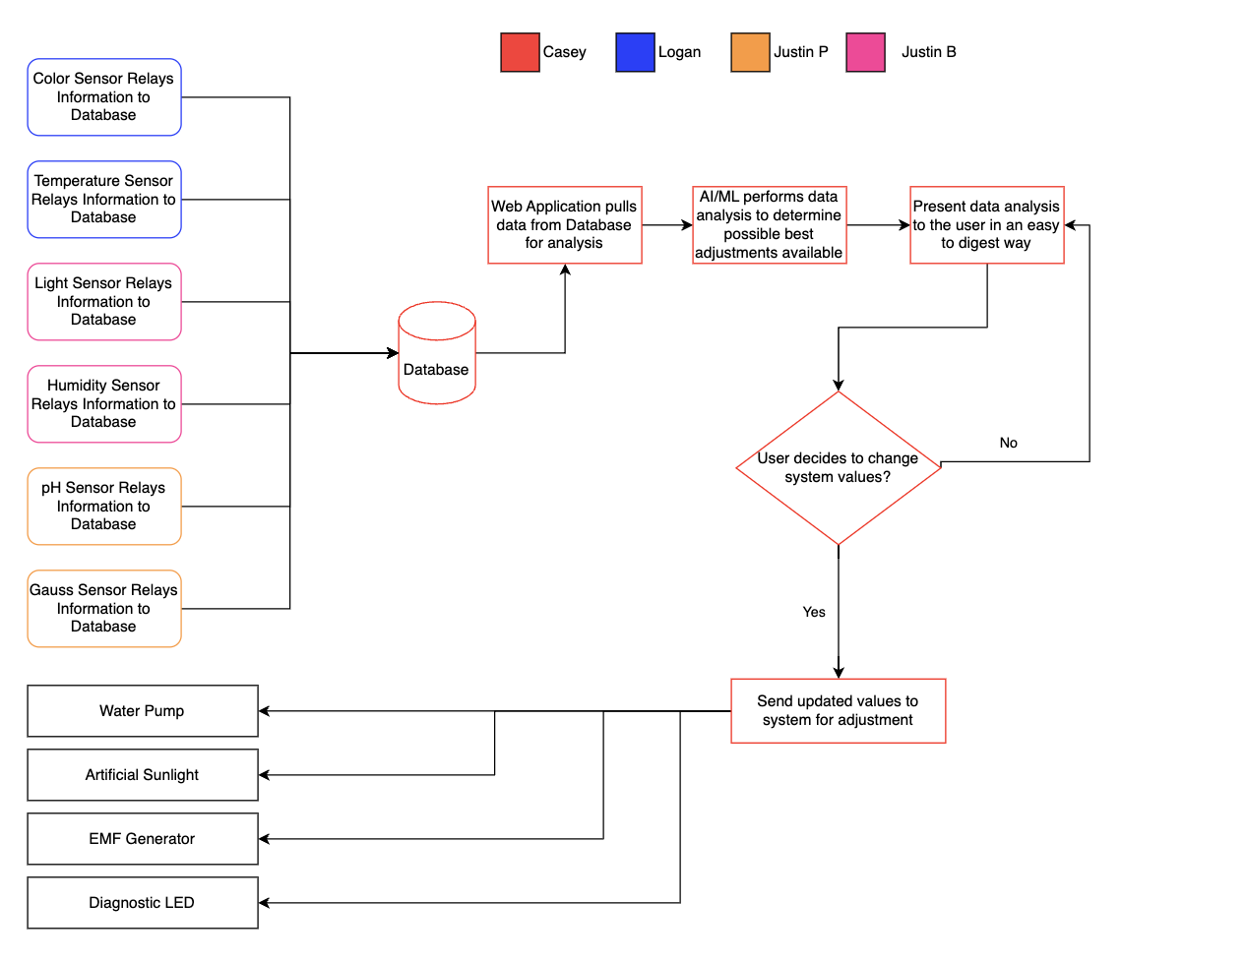
Back-end Framework Selection

Slide 17
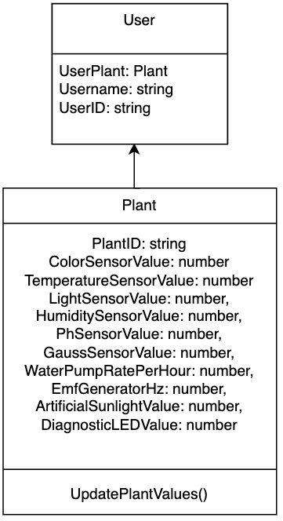
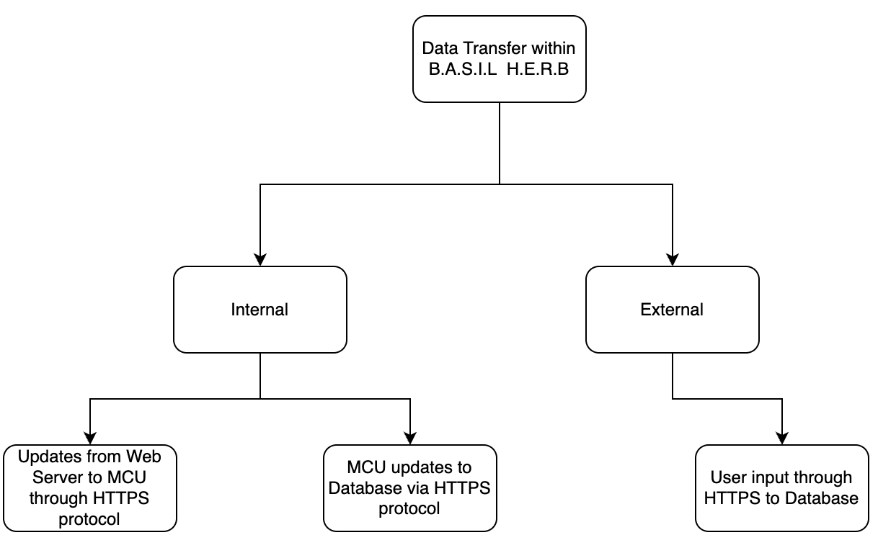
Software Design (Front-end + Database)

Slide 18
Software Design (Back-end 1/2)
User Table
UserID | Username | HashedPassword | PlantID
int | varchar(50) | varchar(250) | int
Measurement Table
McuID | PlantID | Humidity | Temperature | pH | Light | WaterLevel | Color
int | int | float | float | float | int | float | int
Threshold Table
PlantID | WaterRate | EmfValue | DiagnosticLED
int | float | float | int

Slide 19
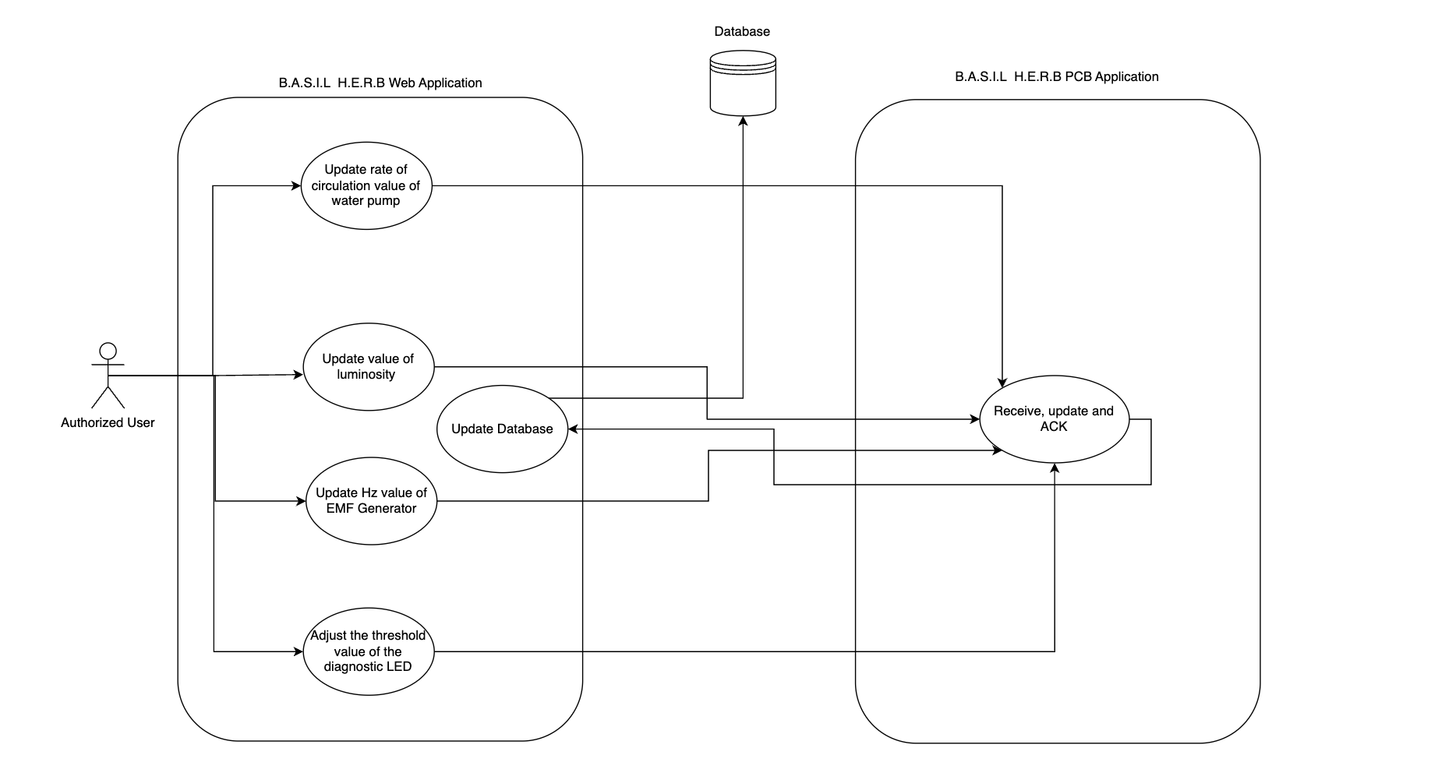
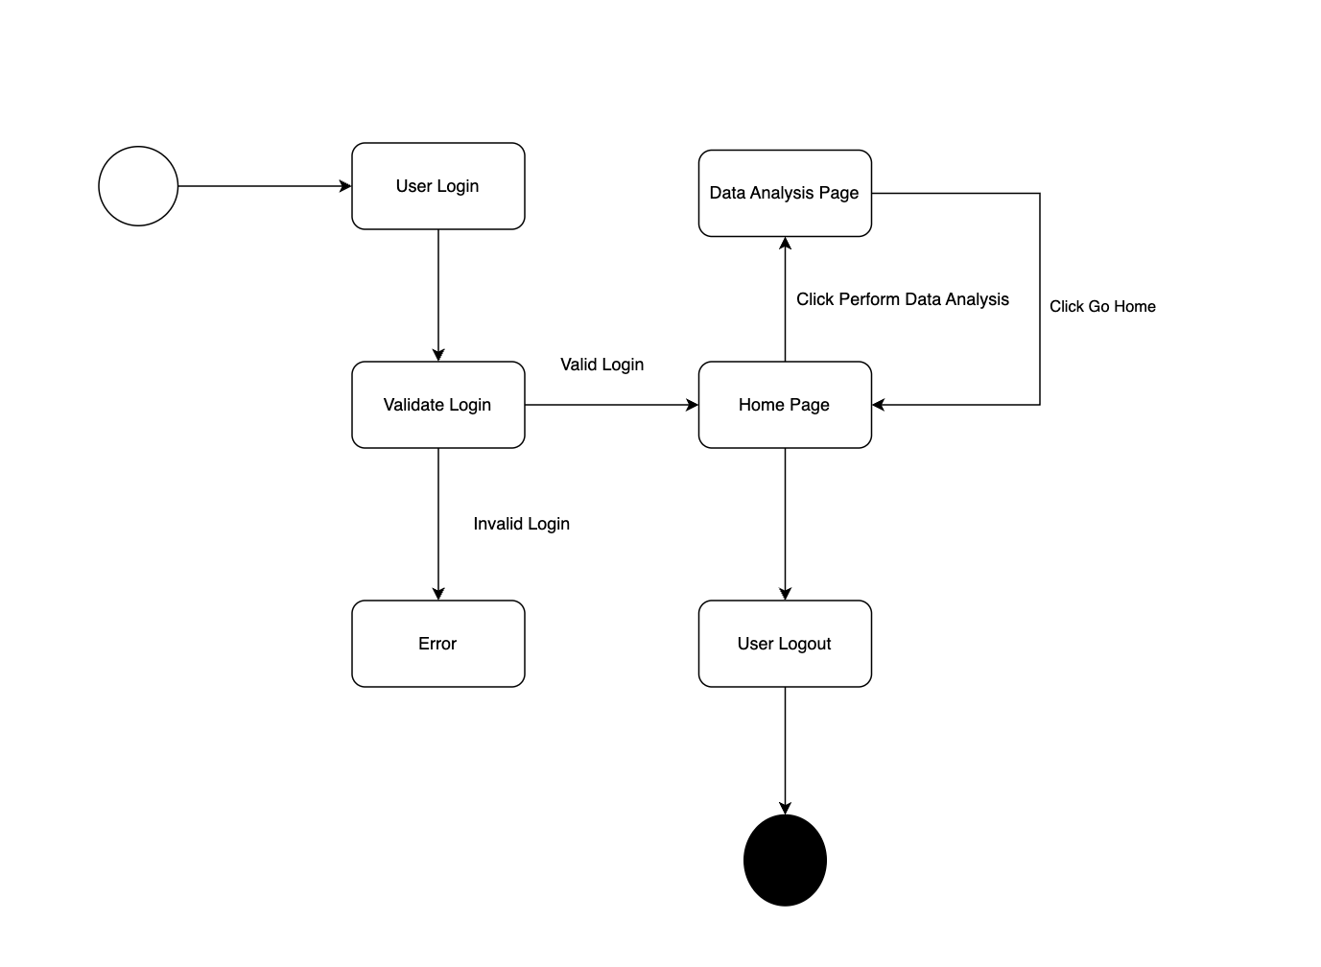
Software Design (Back-end 2/2)

Slide 20
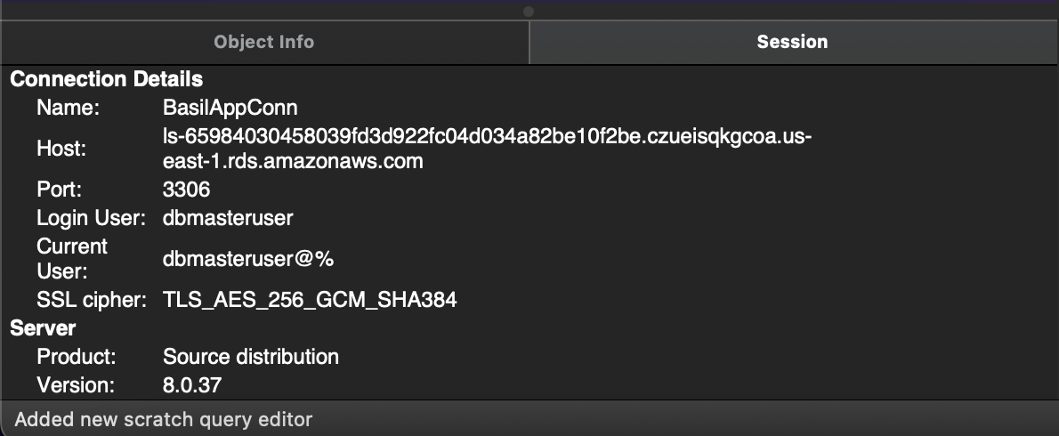
Software Design (Database Creation)

Slide 21
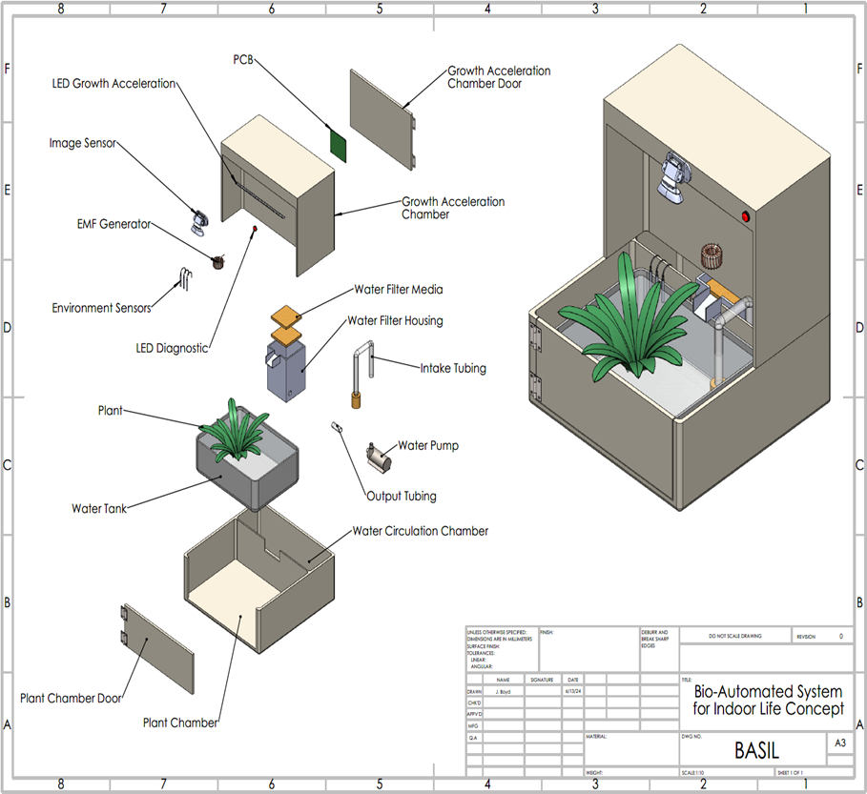
Hardware Design
Growth Acceleration Chamber
Artificial Sunlight LED
Color Sensor
Plant Chamber
Water Pump
Environmental Sensors
Specs

Slide 22
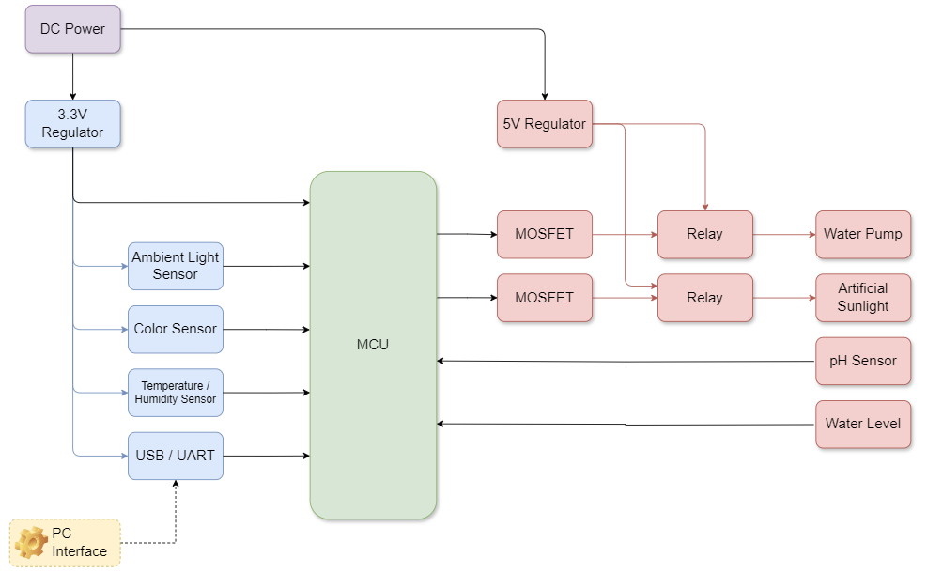
Hardware Block Diagram

Slide 23
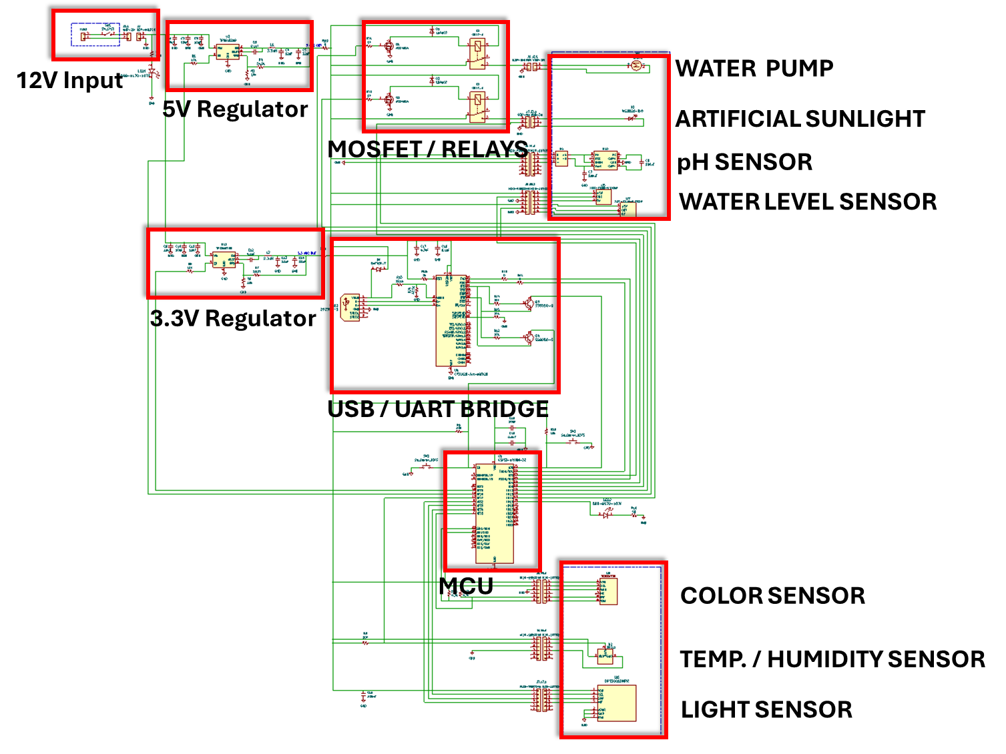
SCHEMATICS
Voltage Regulators
5V Primary Power Draw
Artificial sunlight = 2.6A
Water Pump = 0.96A
3.3V Primary Power Draw
MCU = 0.24A

Slide 24
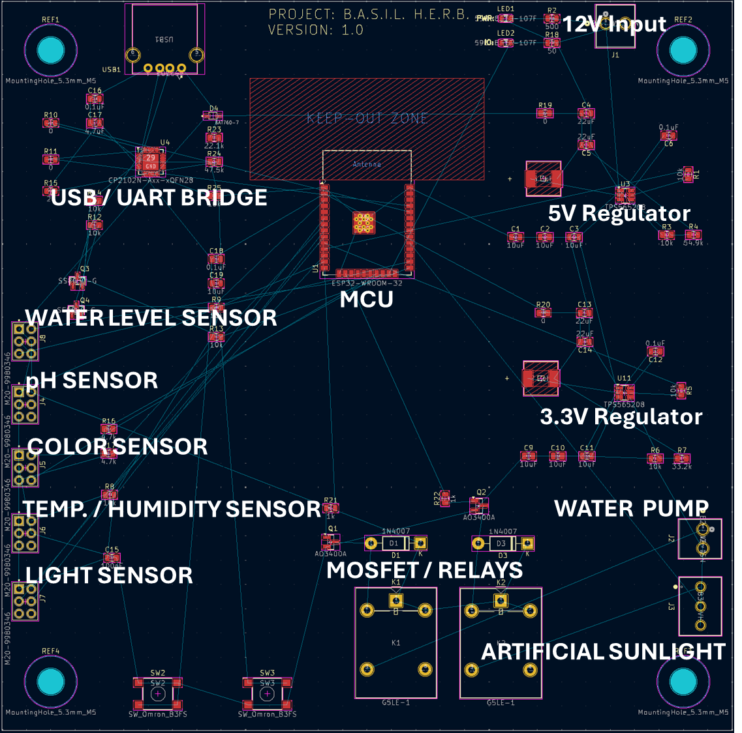
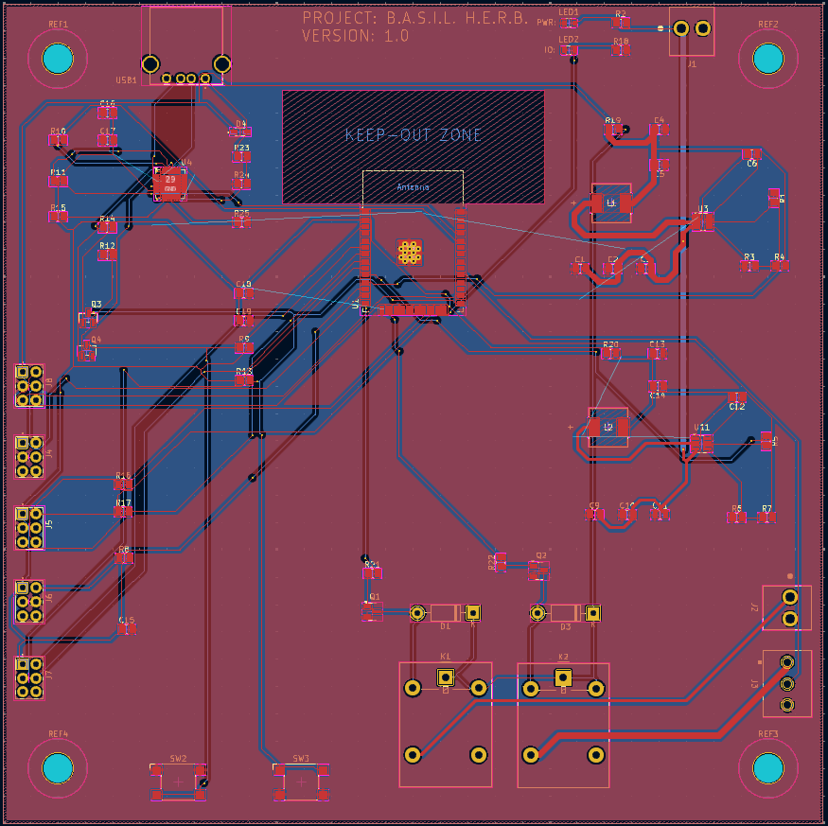
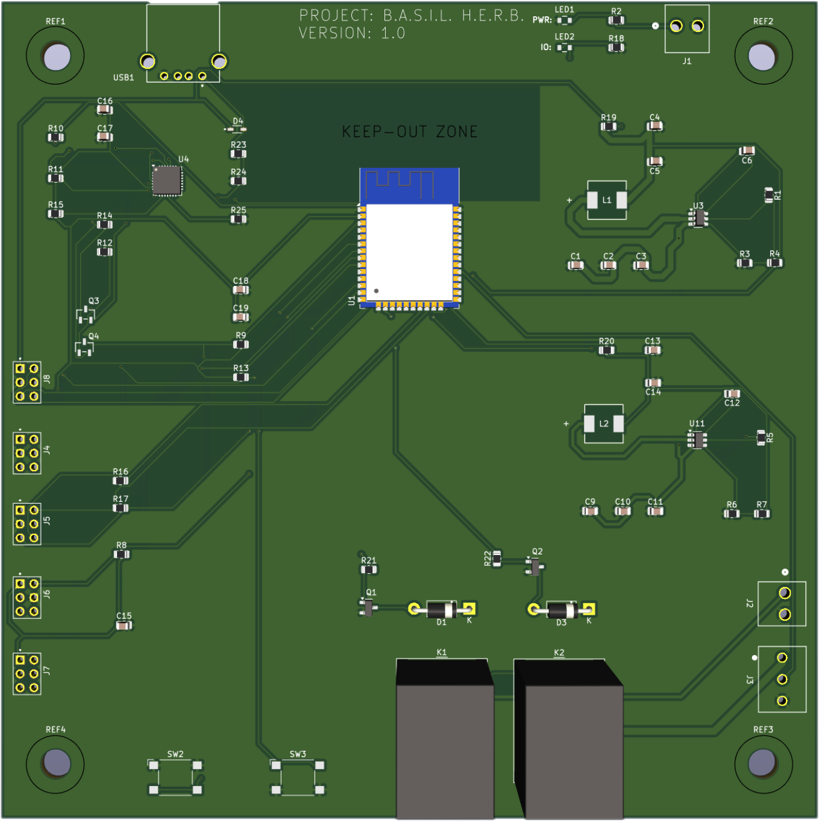
PCB Design

Slide 25


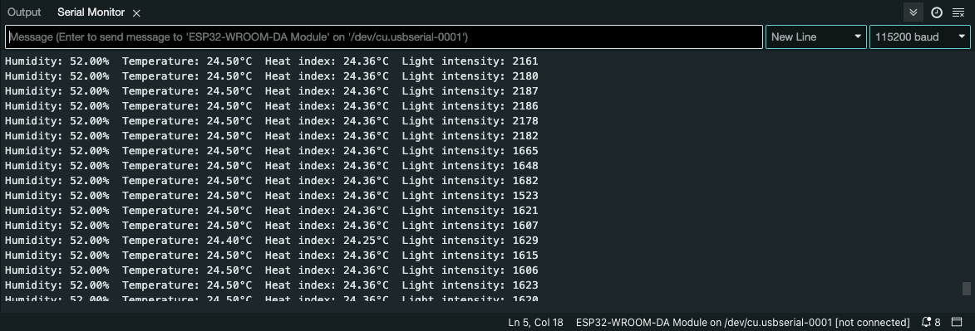
Prototype
Software Testing
Web Application: Frontend (AngularJS, Mocha) & Backend (ExpressJS, Postman)
MCU Communication: WiFi connectivity, HTTP requests, error handling
Sensor Testing
Humidity & Temperature (DHT11)
Light (OPT3001)
Color (TCS34725)
Hardware Testing
Water Pump: Flow rate and dispersion
LED Lights (WS2812B): Voltage, RGB accuracy
Future Plans
Integrate components into fully functional PCB
Test hydroponics system in enclosure (larger than demo)

Slide 26
BASIL HERB
Bio-Automated System with Intelligent Lighting Hydroponics for Enhanced Rapid Bloom
Group 5

